Slide 1
Mini-Project Presentation on Design and Implementation of a Secure Battery Management
System (BMS) with Safety Features for Lithium-based Batteries
Team Members:-
Sumith Subraya Nayak
Tejas S
Sathya M
Utkarsh Kumar karn
Guide Name: Prof. Roopa S
Designation: Assistant Professor
1AY22EC103 1AY22EC124 1AY22EC087
1AY22EC112

Slide 2
TABLE OF CONTENTS
Introduction
Literature Survey
Problem Statement & Objectives
Methodology
Simulink
Components
Serial monitor
Impact
Responsibilities among the group members
Gantt Chart
Reference
Dept. of ECE

Slide 3

INTRODUCTION
Revolutionizing Battery Management Systems (BMS) with advanced monitoring and alert mechanisms
Importance of Battery Management
Critical for electric vehicles, renewable energy, and portable electronics
Ensures battery efficiency, safety, and performance
Key Features of the Project
Continuous monitoring of voltage, temperature, and current
Immediate alerts for abnormal surges, overheating, or irregularities
Real-time data, diagnostics, and early warning alerts
Motivation for the Project
The Pager Attack revealed the importance of secure, advanced monitoring systems.
Motivated us to design a secure Battery Management System (BMS) with enhanced protection.
Focus on preventing exploitation of technology through strong cybersecurity and real-time monitoring.
Aim to safeguard battery-powered systems against both physical and cyber threats.
Applications
Suitable for electric vehicles, energy storage, and portable devices
Ensures top-tier safety and efficiency
Dept. of ECE

Slide 4
LITERATURE SURVEY
TITLE | YEAR | METHODOLOGY | LIMITATION
Battery Management System Hardware Concept | 2022 | - General requirements of a Battery Management System (BMS): - Acquisition of voltage, temperature, and current data. - Robustness against electromagnetic interference (EMI). - Incorporation of redundancy for functional safety. - Exploration of battery pack topologies: - Serial cell configurations. - Parallel cell configurations. - Understanding the impact of these topologies on BMS complexity. | - Challenges highlighted in the study: - Difficulty in maintaining precision in measuring physical parameters (e.g., voltage, temperature) under dynamic operating conditions. - Use of less accurate sensors exacerbates the precision challenge. - Increased cost and complexity when: - Integrating advanced balancing strategies. - Ensuring high levels of redundancy.
Voltage Sensor fault detection, isolation and estimation for lithium-ion battery used in electrical vehicles via a simple and practical method | 2022 | - Voltage sensor fault detection for lithium-ion batteries:: - Structured approach for electric vehicles. - Continuous monitoring of battery parameters: - Voltage. - Temperature. - Current - Use of voltage sensors embedded in the Battery Management System (BMS). | - Limitations of the voltage sensor fault detection approach: - Voltage sensor faults may not be immediately detectable: - Especially when voltage decays slowly due to parasitic capacitance. - Balancing circuit aids in detecting sensor faults but: - May not be effective in all scenarios.
Dept. of ECE

Slide 5
Functional Safety BMS Design Methodology for Automotive Lithium-Based Batteries | 2021 | -V-shaped design approach for developing an enhanced BMS: - Focused on functional safety for automotive lithium-based batteries. - Phases involved: - Hazard and risk assessment. - Defining safety goals. - Specifying technical requirements. - Developing the BMS architecture. - Verifying the system using Failure Modes, Effects, and Diagnostics Analysis (FMEDA). - Compliance: - Aimed at meeting Automotive Safety Integrity Level (ASIL) C standards. | Limitations of the V-shaped design approach: - Reliance on reliability data sources: - Due to the high cost and complexity of accelerated component testing. - Challenges in hazard and risk assessments: - Dependence on qualitative judgments when public quantitative data is unavailable. - Potential impact on the accuracy of risk evaluations and safety measures.
Thermal state monitoring of lithium-ion batteries: Progress, challenges, and opportunities | 2023 | Hybrid approach for battery state-of-temperature (SOT) estimation: - Integration of machine learning models (e.g., LSTM-RNN) with thermal models. - Data inputs: - Current. - Voltage. - Ambient temperature. - Data collected from both lab experiments and field tests. -Model operation: - Models function either sequentially or in parallel. - AdaBoost is used to combine outputs from the models. | - Challenges of hybrid method: - Reliance on the accuracy of thermal models: - Inaccurate models can reduce overall performance. - Data-driven components: - Require large, well-labeled datasets. - Thermal models: - Must be carefully parameterized, adding to complexity. - Computational demand: - Can be resource-intensive, limiting use in real-time or resource-constrained applications.
Dept. of ECE

Slide 6
PROBLEM STATEMENT:-
Unauthorized modifications to the Battery Management System (BMS) firmware have disabled safety mechanisms in lithium-based batteries, leading to thermal runaway and explosions. This project aims to develop a secure BMS to prevent tampering and ensure battery safety in critical devices.
OBJECTIVES:-
1. Study the Battery Management System (BMS): To understand the core functions and components of a BMS, including battery monitoring, state of charge (SOC), and safety mechanisms. It involves studying various BMS implementations, challenges such as balancing and thermal management, and their application in different industries.
2. Integrate a Tamper-Resistant Battery Management System: Enhancing BMS security by integrating tamper detection, secure communication protocols, and physical protection mechanisms. It ensures the system is resilient against unauthorized access and complies with safety and security standards.
Dept. of ECE

Slide 7
Methodology
Microcontroller
(Arduino/ESP32)
Battery Protection Circuit
Li-ion
Battery pack
Li-ion
Battery pack
Battery Protection Circuit
Dept. of ECE
Temperature sensor
Temperature sensor
BMS Firmware
BMS Firmware
Voltage sensor
Voltage sensor
Safety Protocols
Safety Protocols
Current sensor
Current sensor

Slide 8
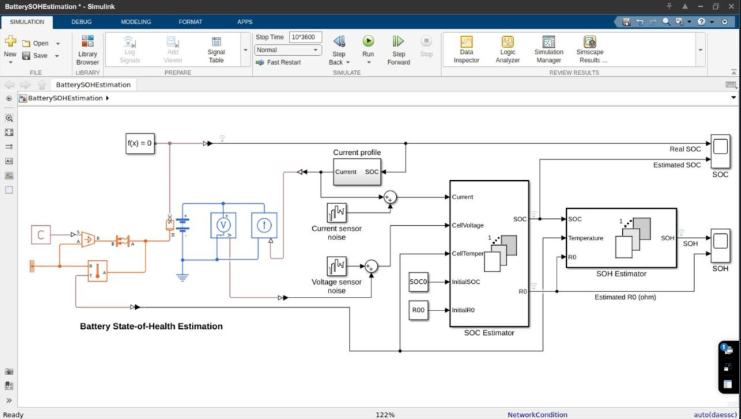
Simulink
Dept. of ECE

Slide 9
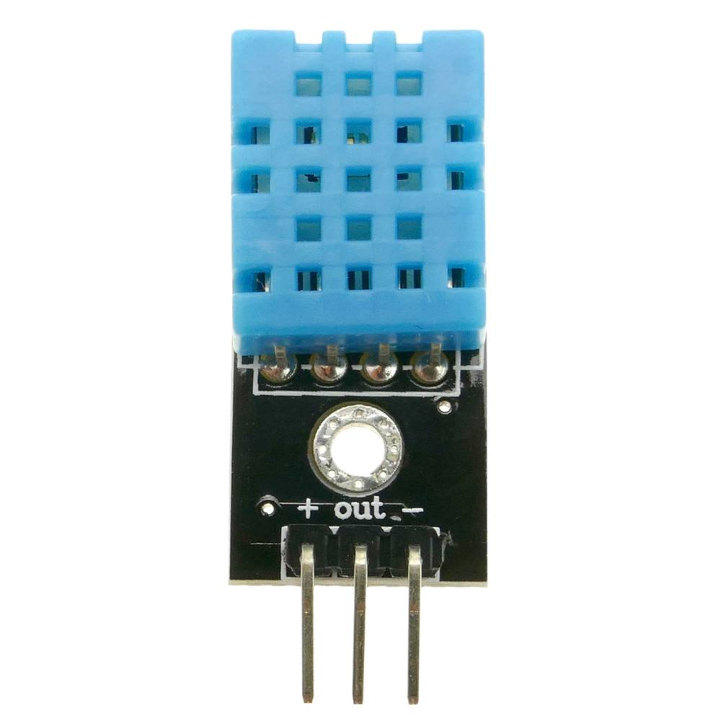
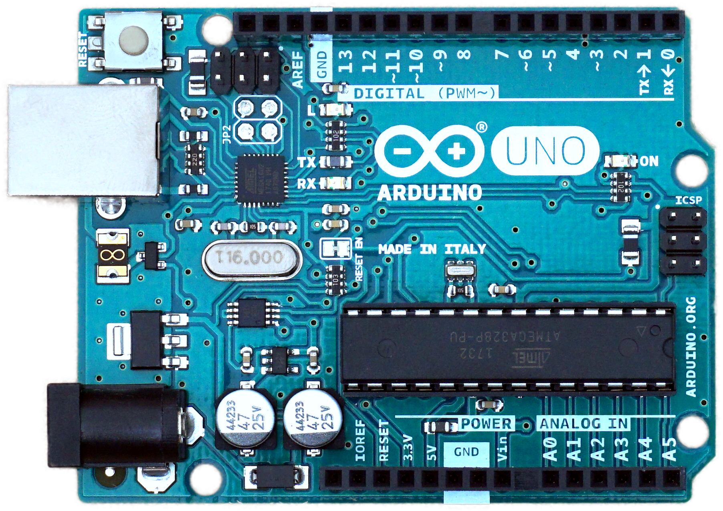
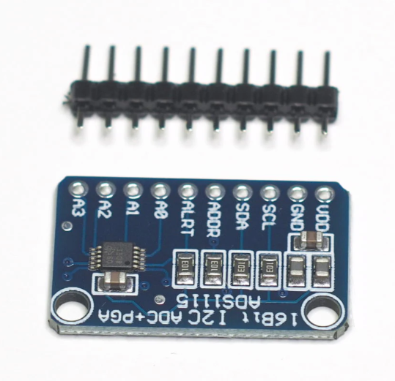
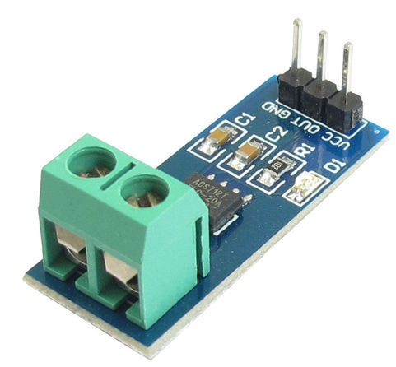
Components
Thermal sensor
(DHT11)
Microcontroller
Arduino UNO r3
Dept. of ECE
Voltage sensor
(ADS1115)
Current sensor
(ACS712)

Slide 10
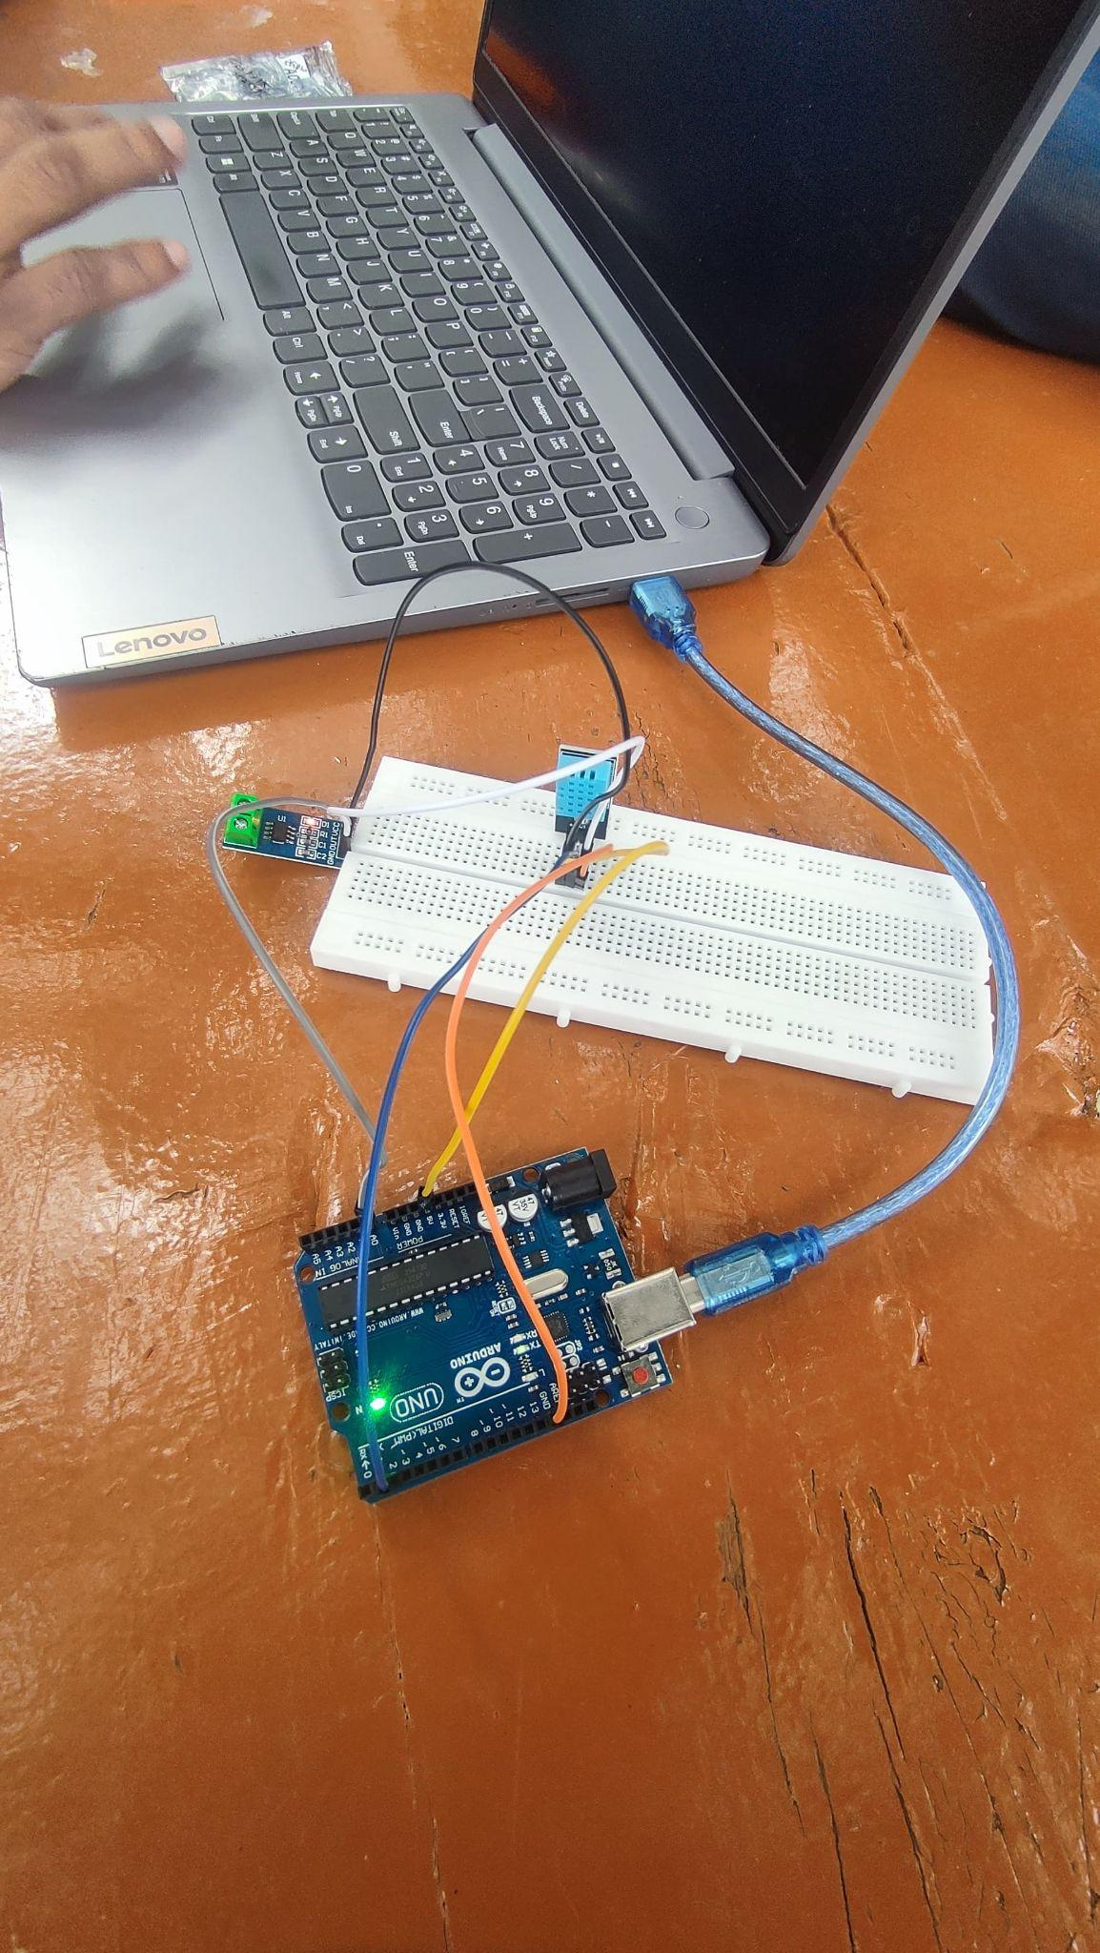
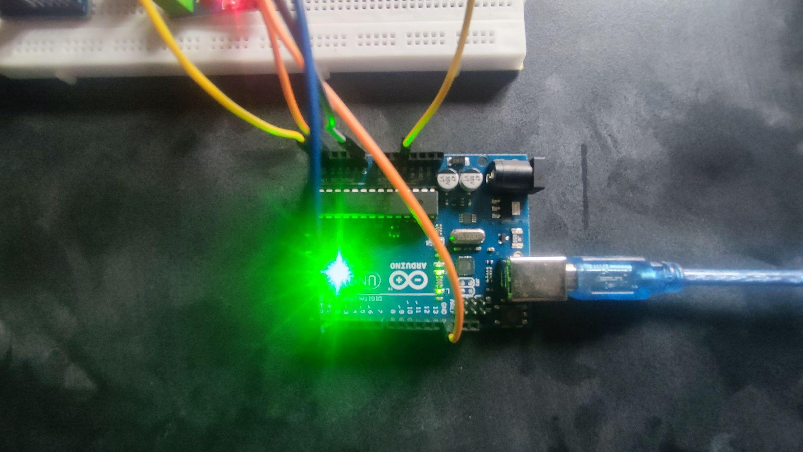
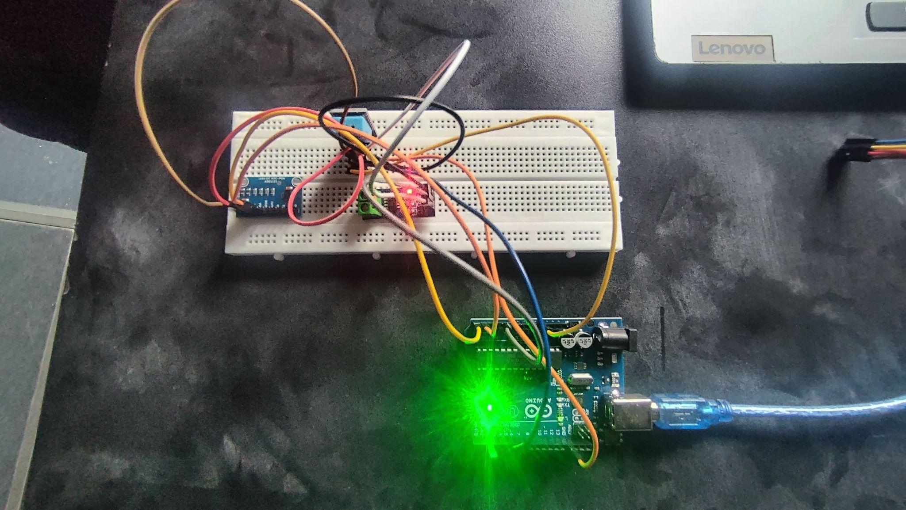
Dept. of ECE

Slide 11
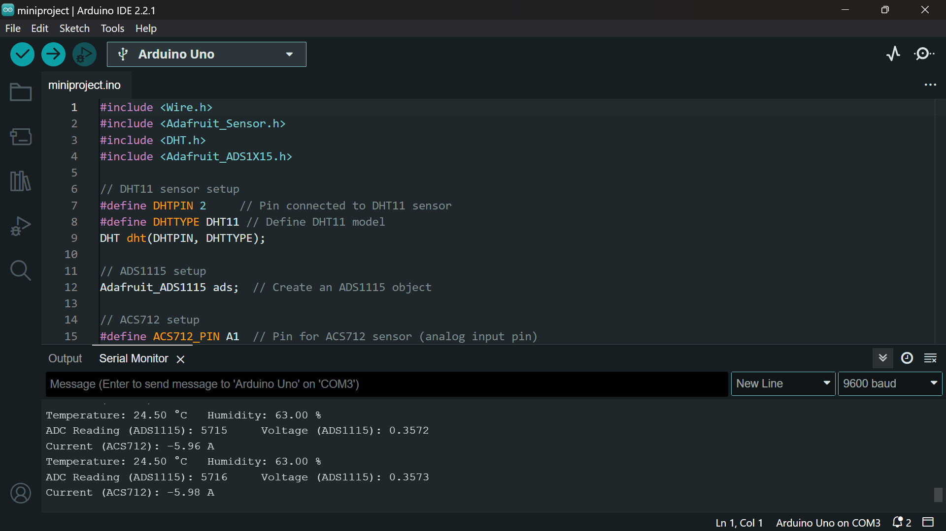
Serial monitor
Dept. of ECE

Slide 12
Impact
Enhanced Safety:
Prevents battery malfunctions (overcharging, overheating).
Incorporates fail-safe mechanisms for emergency disconnection.
Data Integrity and Privacy:
Ensures accurate monitoring of battery performance.
Protects against unauthorized access and cyber threats.
Increased Battery Lifespan:
Optimizes charging and discharging processes.
Facilitates early fault detection and intervention.
Improved System Efficiency:
Ensures optimal battery performance through effective management.
Enhances energy utilization and minimizes losses.
Technological Impacts
Innovation in Battery Technology: The development of a secure BMS may drive innovation in battery technology, leading to advancements in battery chemistry and efficiency.
Integration with IoT: A secure BMS can be integrated with IoT devices for real-time monitoring and management, enabling smarter energy solutions.
Sustainability:
Reduces e-waste and energy consumption.
Informs battery recycling and reuse strategies.
Dept. of ECE

Slide 13
Responsibilities among the group members
1. Lead researcher (Sumith Subraya Nayak):
Oversee project timeline and milestones. Coordinate team meetings and communication.
Manage project documentation and liaise with Guide. Monitor progress and provide updates.
2. Hardware Engineer (Utkarsh Kumar karn):
Design and implement BMS hardware. Select sensors and microcontroller.
Develop circuit design and integrate protection circuits. Test and troubleshoot hardware.
3. Firmware Developer (Tejas S):
Develop firmware for the microcontroller. Implement safety protocols and secure updates.
Ensure hardware-firmware integration. Debug and validate firmware.
4. Testing and Validation Engineer (Sathya M):
Create and execute test plans. Test for thermal runaway and failure modes.
Analyze data and ensure system safety standards. Document results and suggest improvements.
Dept. of ECE

Slide 14
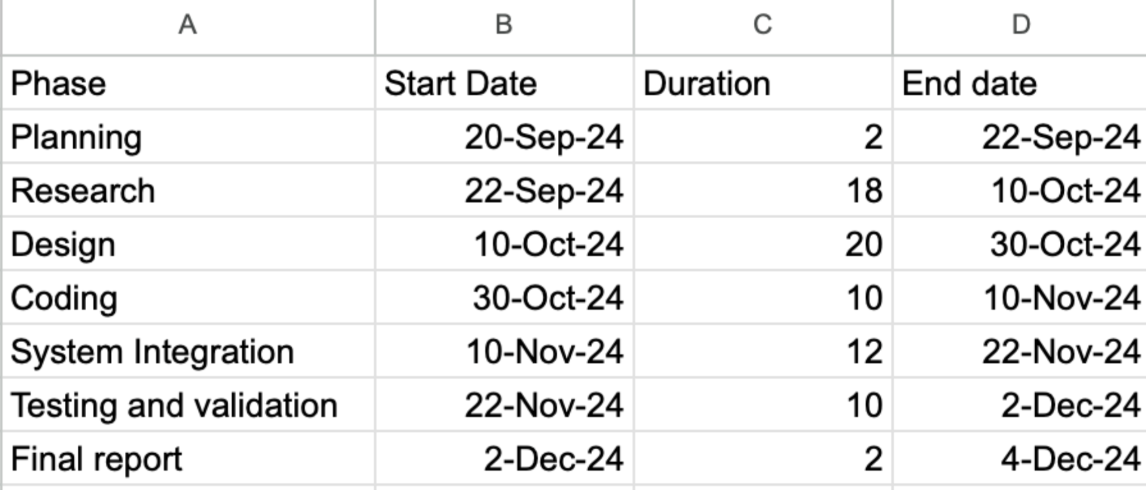
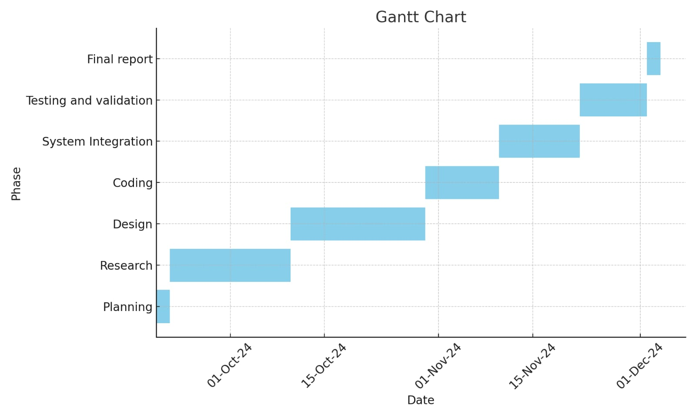
Gantt Chart
Dept. of ECE

Slide 15
REFERENCE
[1] Markus Lelie, Thomas Braun, Marcus Knips, Hannes Nordmann, Florian Ringbeck, Hendrik Zappen, Dirk Uwe Sauer. (2022). "Battery Management System Hardware Concepts: An Overview." Applied Sciences, 8(4), 534. Published on: 30 March 2022
[2] Balakumar Balasingam, Mostafa Ahmed, Krishna Pattipati. (2022). "Voltage Sensor fault detection, isolation and estimation for lithium-ion battery used in electrical vehicles via a simple and practical method." Energies, 13(11), 2825. Published on: 2 June 2022
[3] David Marcos, Maitane Garmendia, Jon Crego, José Antonio Cortajarena. (2021). "Functional Safety BMS Design Methodology for Automotive Lithium-Based Batteries." Energies, 14(21), 6942. Published on: 21 October 2021​
[4]Yusheng Zheng, Yunhong Che, Xiaosong Hu, Xin Sui, Daniel-Ioan Stroe, Remus Teodorescu.(2023)."Thermal state monitoring of lithium-ion batteries: Progress, challenges, and opportunities." Progress in Energy and Combustion Science, 100, 101120. Published on: 22 September 2023.
Dept. of ECE

